Slide 1


BMB3015 ARTIFICIAL INTELLIGENCE
CONSTRAINT SATISFACTION PROBLEMS

Slide 2

Map-Coloring Problem
Variables WA, NT, Q, NSW, V, SA, T
Domains D_{i} = {red, green, blue}
Constraints: adjacent regions must have different colors
e.g., WA ≠ NT, or (WA,NT) in {(red, green),(red, blue),(green, red), (green, blue),(blue, red),(blue, green)}

Slide 3
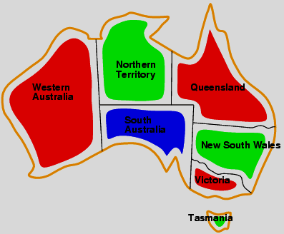
Map-Coloring Problem
Solutions are complete and consistent assignments,
e.g., WA = red, NT = green, Q = red, NSW = green, V = red,
SA = blue, T = green

Slide 4
Outline
Constraint Satisfaction Problems (CSP)
Backtracking search for CSPs
Local search for CSPs

Slide 5
Constraint Satisfaction Problems
Standard search problem:
state is a black box – any data structure that supports successor function, heuristic function, and goal test
Constraint Satisfaction Problem (CSP):
state is defined by variables X_{i} with values from domain D_{i}
goal test is a set of constraints that specify allowable combinations of values for subsets of variables
Simple example of a formal representation language
Allows useful general-purpose algorithms with more power than standard search algorithms

Slide 6
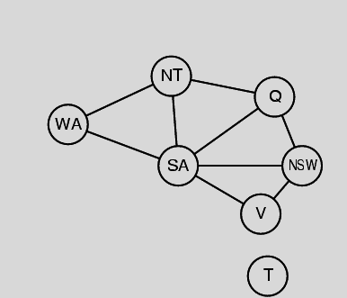
Constraint Graph
Binary CSP: each constraint relates two variables
Constraint graph: nodes are variables, arcs are constraints

Slide 7
Varieties of CSPs
Discrete variables
finite domains
n variables, domain size d → O(d^{n}) complete assignments
e.g., Boolean CSPs, variables can be either true or false
infinite domains
integers, strings, etc.
e.g., job scheduling, variables are start/end days for each job
need a constraint language, e.g., StartJob₁ + 5 ≤ StartJob₃
continuous domains
common in real world and widely studied in the field of operations research
e.g., start/end times for Hubble Space Telescope observations and maneuver
linear constraints solvable in polynomial time by linear programming
constraints must be linear equalities forming a convex region
Notes:
Hubble Space Telescope
çok büyük uzaklıklara ilişkin gözlem yapabilmek için tasarlanmış bir gözlemevi
e.g., Boolean CSPs, include Boolean satisfiability (NP-complete)

Slide 8
Varieties of Constraints
Unary constraints involve a single variable,
e.g., SA ≠ green
Binary constraints involve pairs of variables,
e.g., SA ≠ WA
Higher-order constraints involve 3 or more variables,
e.g., cryptarithmetic column constraints

Slide 9
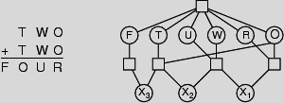
Example: Cryptarithmetic
Constraint hypergraph
Variables: F T U W R O X₁ X₂ X₃
X₁ X₂ X₃ are auxiliary representing the digit 0 or 1
Domains: {0,1,2,3,4,5,6,7,8,9}
Constraints: Alldiff (F, T, U, W, R, O)
O + O = R + 10 · X₁
X₁ + W + W = U + 10 · X₂
X₂ + T + T = O + 10 · X₃
X₃ = F, T ≠ 0, F ≠ 0

Slide 10
Real-World CSPs
Assignment problems
e.g., who teaches what class
Time tabling problems
e.g., which class is offered when and where?
Transportation scheduling
Factory scheduling
Notice that many real-world problems involve real-valued variables

Slide 11
Standard Search Formulation (Incremental)
Start with the straightforward approach, then fix it
States are defined by the values assigned so far
Initial state: the empty assignment { }
Successor function: assign a value to an unassigned variable that does not conflict with current assignment
→ fails if no legal assignments
Goal test: the current assignment is complete

Slide 12
Standard Search Formulation (Incremental)
This is the same for all CSPs
Every solution appears at depth n with n variables
→ use depth-first search
Path is irrelevant, so can also use complete-state formulation
b = (n - l )d at depth l , hence n! d^{n} states
nd+n.d*n-1.d+n.d*n-1.d*n-2*d+…+ n! d^{n}
Notes:
nd+n.d*n-1.d+n.d*n-1.d*n-2*d…

Slide 13
Backtracking Search
In a CSP variable assignments are commutative,
if order of application of any given set of actions has no effect on the outcome
i.e., [ WA = red then NT = green ] same as [ NT = green then WA = red ]
A CSP only needs to consider assignments to a single variable at each node
→ Then since b = d, there are d^{n} possible leaves
Depth-first search for CSPs with single-variable assignments is called backtracking search
Backtracking search is the basic uninformed algorithm for CSPs
Can solve n-queens for n ≈ 25

Slide 14
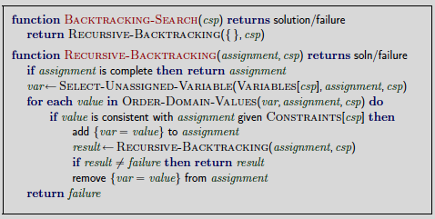
Backtracking Search
SELECT-UNASSIGNED-VARIABLE and ORDER-DOMAIN-VALUES
can be used to implement the general purpose heuristics

Slide 15

Backtracking Example

Slide 16
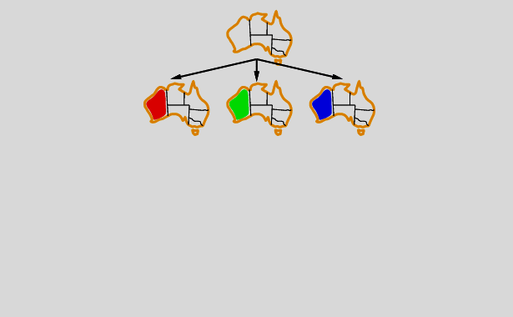
Backtracking Example

Slide 17
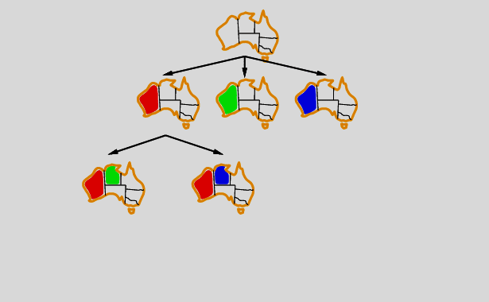
Backtracking Example

Slide 18
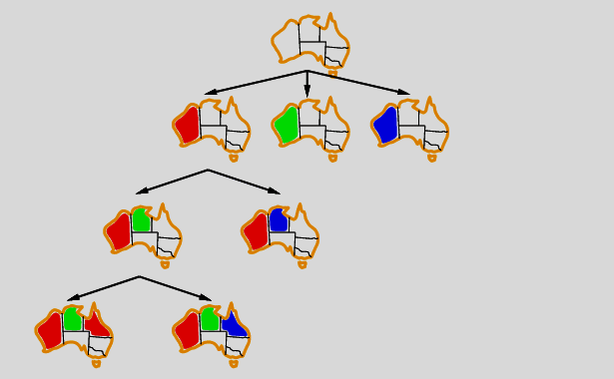
Backtracking Example

Slide 19
Improving Backtracking Efficiency
Uninformed search algorithms are improved with domain-specific heuristics
In CSP general-purpose methods can give huge gains in speed:
Which variable should be assigned next?
In what order should its values be tried?
Can we detect inevitable failure early?

Slide 20

Minimum Remaining Values Heuristic: Most Constrained Variable
SELECT-UNASSIGNED-VARIABLE selects the next unassigned variable in the order given by the list VARIABLES[csp] by default.
Known as variable ordering
Most constrained variable:
choose the variable with the fewest legal values
Also known as minimum remaining values (MRV) heuristic or fail-first heuristic

Slide 21

Degree Heuristic: Most Constraining Variable
Tie-breaker among most constrained variables
Most constraining variable:
choose the variable with the most constraints on remaining variables

Slide 22

Least Constraining Value
Given a variable, choose the least constraining value:
the one that rules out the fewest values in the remaining variables
also known as value selection
! Combining these heuristics makes 1000 queens feasible

Slide 23
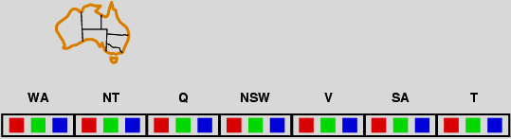
Forward Checking
So far constraints applied only during variable selection
Looking constraints earlier in the search, search space can be reduced
Idea:
Keep track of remaining legal values for unassigned variables
Terminate search when any variable has no legal values

Slide 24
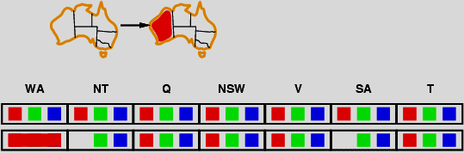
Forward Checking
Idea:
Keep track of remaining legal values for unassigned variables
Terminate search when any variable has no legal values

Slide 25
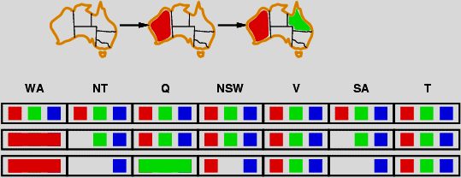
Forward Checking
Idea:
Keep track of remaining legal values for unassigned variables
Terminate search when any variable has no legal values

Slide 26
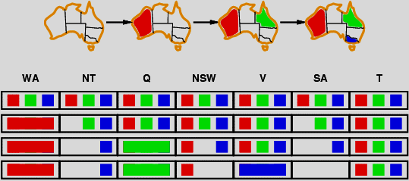
Forward Checking
Idea:
Keep track of remaining legal values for unassigned variables
Terminate search when any variable has no legal values

Slide 27
Constraint Propagation
Forward checking propagates information from assigned to unassigned variables, but doesn't provide early detection for all failures.
NT and SA cannot both be blue!
Constraint propagation repeatedly enforces constraints locally

Slide 28
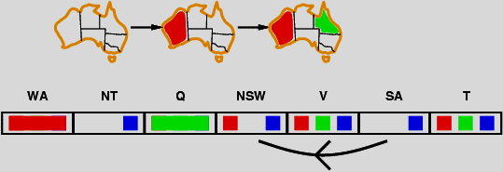
Arc Consistency
Simplest form of propagation makes each arc consistent
X →Y is consistent iff
for every value x of X there is some allowed y for Y

Slide 29
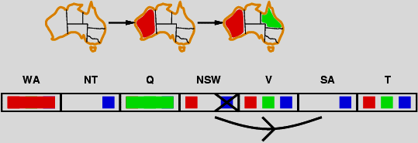
Arc Consistency
Simplest form of propagation makes each arc consistent
X →Y is consistent iff
for every value x of X there is some allowed y for Y
If X loses a value, neighbors of X need to be rechecked

Slide 30
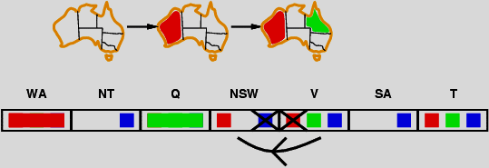
Arc Consistency
Simplest form of propagation makes each arc consistent
X →Y is consistent iff
for every value x of X there is some allowed y for Y
If X loses a value, neighbors of X need to be rechecked

Slide 31
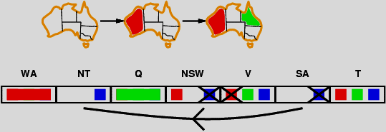
Arc Consistency
Simplest form of propagation makes each arc consistent
X →Y is consistent iff
for every value x of X there is some allowed y for Y
If X loses a value, neighbors of X need to be rechecked
Arc consistency detects failure earlier than forward checking
Can be run as a preprocessor or after each assignment

Slide 32
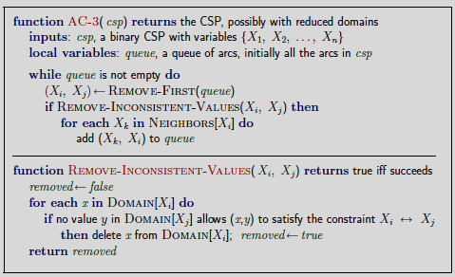
Arc Consistency Algorithm AC-3
Time complexity: O(n²d³)
a binary CSP has O(n²) arcs
each arc can be inserted into queue d times
checking arc consistency has O(d²)

Slide 33
Local Search for CSPs
Hill-climbing, simulated annealing typically work with "complete" states, i.e., all variables assigned
To apply to CSPs:
allow states with unsatisfied constraints
operators reassign variable values
Variable selection: randomly select any conflicted variable
Value selection by min-conflicts heuristic:
choose value that violates the fewest constraints
i.e., hill-climb with h(n) = total number of violated constraints

Slide 34
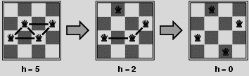
Example: 4-Queens
States: 4 queens in 4 columns (4⁴ = 256 states)
Actions: move queen in column
Goal test: no attacks
Evaluation: h(n) = number of attacks
Given random initial state, can solve n-queens in almost constant time for arbitrary n with high probability (e.g., n = 10,000,000)

Slide 35
Summary
CSPs are a special kind of problem:
states defined by values of a fixed set of variables
goal test defined by constraints on variable values
Backtracking = depth-first search with one variable assigned per node
Variable ordering and value selection heuristics help significantly
Forward checking prevents assignments that guarantee later failure
Constraint propagation (e.g., arc consistency) does additional work to constrain values and detect inconsistencies
Iterative min-conflicts is usually effective in practice

